Slide 1
Community Consultative Committee – February 2026
25 February 2026

Slide 2
WELCOME AND APOLOGIES
Welcome
Apologies
Declaration of interests
Confirmation of previous minutes

Slide 3
AGENDA
Actions from Previous Meeting
Correspondence
Operational Update
Approvals
IPC Hearing
Environmental Incidents / Non-compliances
Environmental Performance
Community Complaints & Enquiries

Slide 4
ACTIONS / BUSINESS ARISING FROM PREVIOUS MINUTES
Action / Business Arising | Action Owner | Update

Slide 5
CORRESPONDENCE
Correspondence since the previous meeting
18/11/2025 – Email MMH to CCC updated Terms of Reference with draft minutes. Presentation and reports.

Slide 6
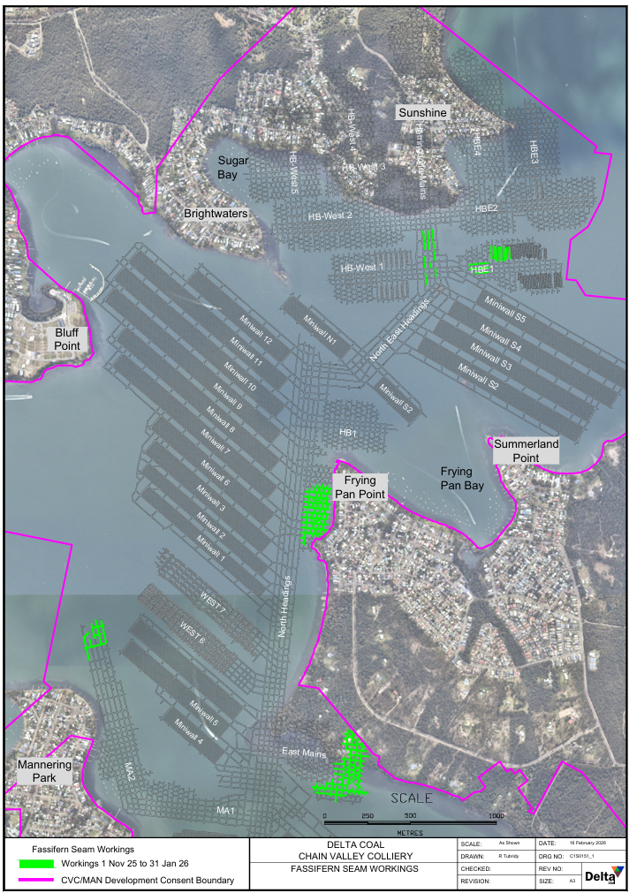
OPERATIONAL UPDATE
Production
Secondary extraction in N East Headings.
Continued First workings in HB-2 Panel.
Continuation of workings through MA2 (heavily faulted area).
Continued first workings in South One.
Production 1 November 2025 to 31 January 2026 was 246,859t ROM Coal.

Slide 7
APPROVALS
Current Approvals
Chain Valley Colliery
EPL 1770: Environmental Protection License - April 2025.
CVC SSD-5465 (MOD 4): Development Consent – August 2021
Extraction Plan: MWS5 and NPA (Amendment 3 approved 6th February 2026)
Mannering Colliery
EPL 191 – Mannering Colliery – June 2025
Mannering Colliery Project Approval PA 06_0311 (MOD 5) – June 2020
Notes:
Amendment 3 of the EP has been developed to reflect an update to the proposed areas of secondary pillar extraction. The proposed areas are the North East and North Headings, which remain within Zone B as specified in the CVC Development Consent SSD-5465.
The amendment is supported by geotechnical assessment and subsidence prediction for a double-sided lifting scenario in the North East and North Headings, included in Appendix 15.4. The location and proposed design of the double-sided lifting in North East and North Headings is depicted as Method A on Plan 9 – Mining Sequence in Appendix 14 – Graphical plans

Slide 8
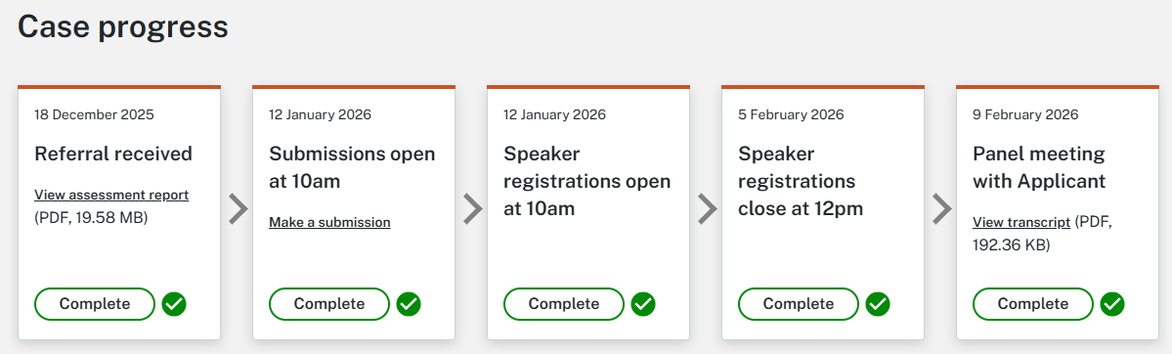
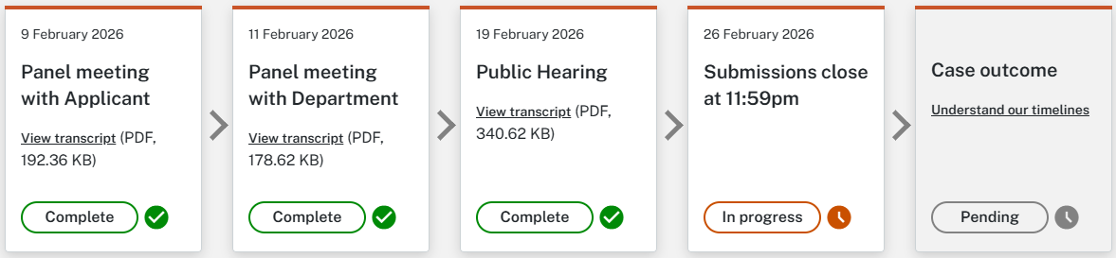
Make a submission for the project:
APPROVALS UPDATE
https://www.ipcn.nsw.gov.au/form/chain-valley-colliery-consolidation
Chain Valley Consent Consolidation | Referred to the NSW Independent Planning Commission. The Commission completed a site visit on 18th February. Public hearing completed on 19th February. Public Submissions Close 26th February.

Slide 9
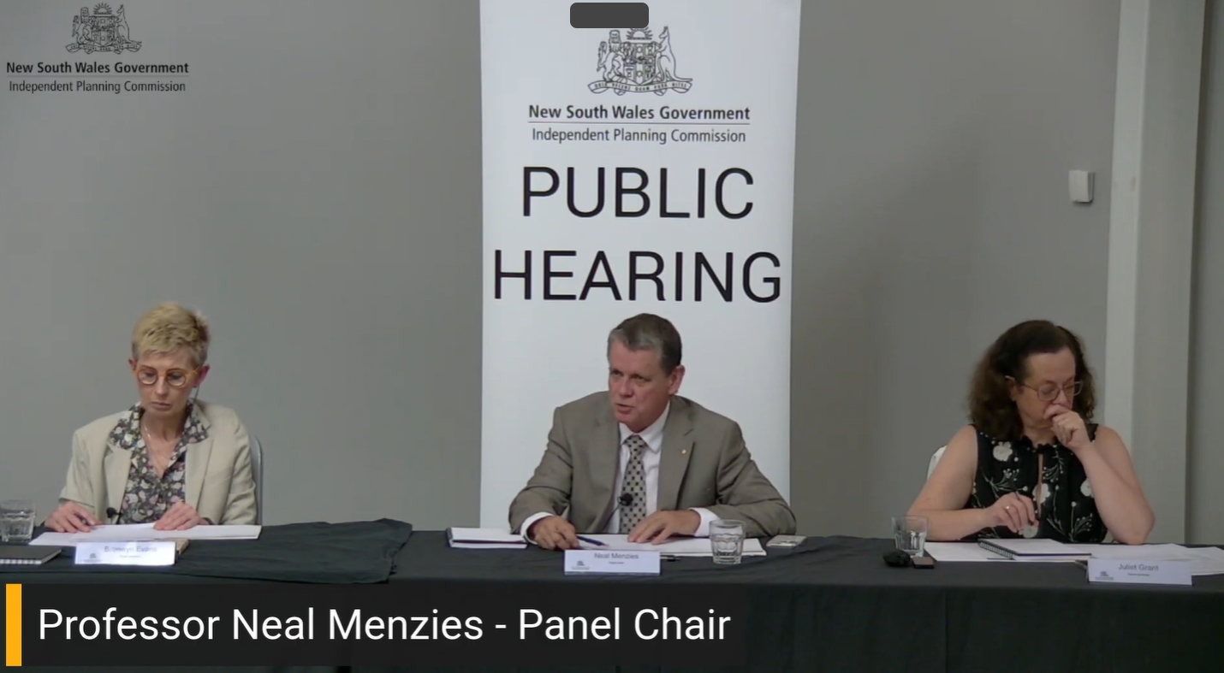
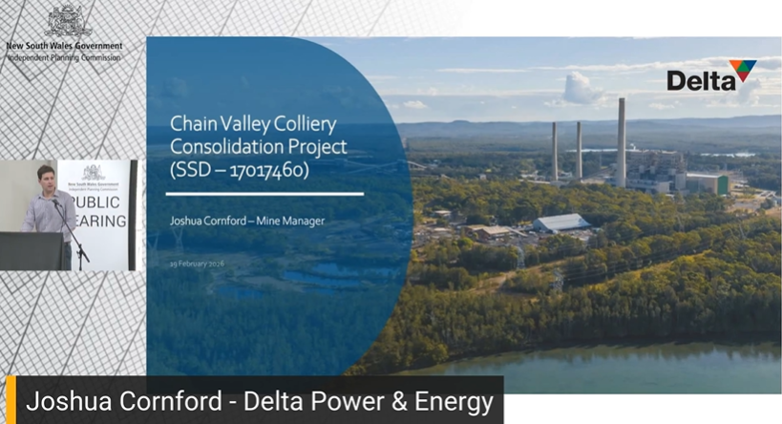
IPC Public Hearing

Slide 10


APPROVALS UPDATE
Mannering Colliery Project Approval (MP06_0311) Mod 6 | With DoP for approval.

Slide 11
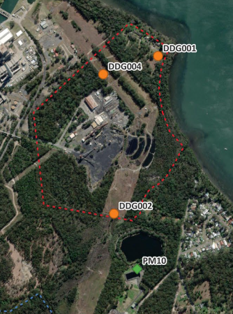
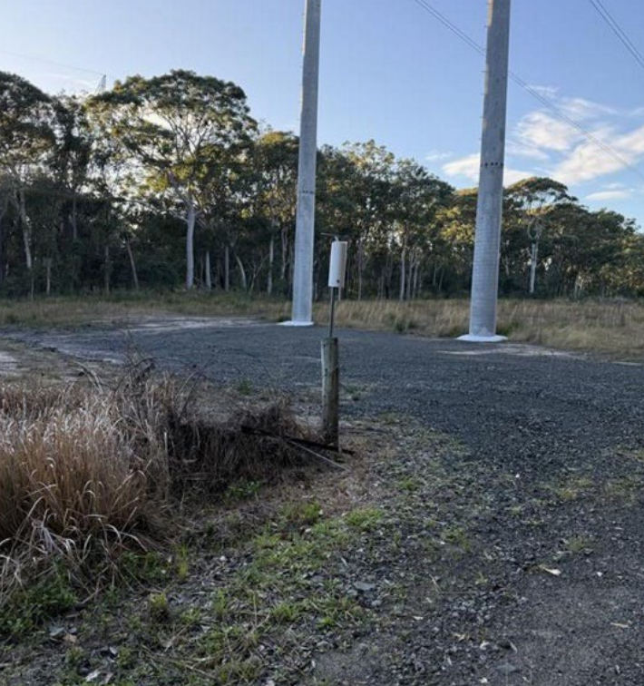
ENVIRONMENTAL INCIDENTS / NON-COMPLIANCES
Site | CVC
Date | 5 November 2025
Type | Depositional Dust
Details | Exceedance of maximum increase to depositional dust levels in a month period at DG004 at Chain Valley Colliery. Deemed to be unrelated to mine operations.

Slide 12
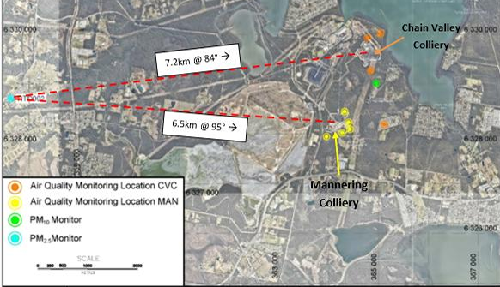
ENVIRONMENTAL INCIDENTS / NON-COMPLIANCES
Site | CVC and MC
Date | 9 December 2025
Type | Particulate Matter 2.5 (PM2.5)
Details | Exceedance of maximum increase to depositional dust levels in a 24hr period at Beta-attenuation monitoring (BAM) unit (RTD002). Regional Air quality event due to bush fires. Deemed to be unrelated to mine operations.

Slide 13
ENVIRONMENTAL INCIDENTS / NON-COMPLIANCES
Site | CVC and MC
Date | 16 December 2025
Type | Administrative
Details | Within three months of the Department of Planning approval of the three yearly independent environmental audit the review of management plans must be completed. Due to staffing changes and onsite projects it was requested that an extension be given till 30 March 2026.

Slide 14
ENVIRONMENTAL INCIDENTS / NON-COMPLIANCES
Site | CVC
Date | 2025
Type | Depositional Dust
Details | For the 2025 period, one depositional dust gauge, DDG004, was considered to have been frequently exposed to contamination unrelated to CVCs mining activities. The annual average value for DDG004 exceeded the 4 g/m2 month annual average limit. The annual average was 5.79 g/m2.

Slide 15
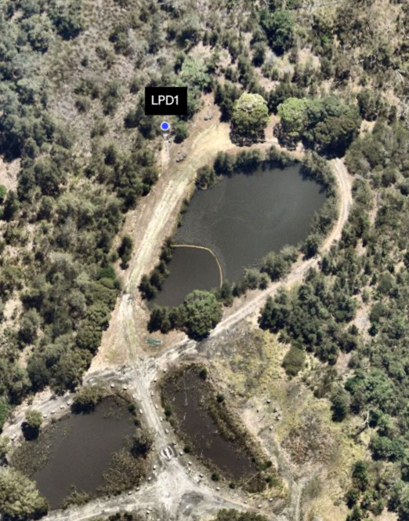
ENVIRONMENTAL INCIDENTS / NON-COMPLIANCES
Site | MC
Date | 6 January 2026
Type | pH exceedance at LDP1
Details | Weekly sampling from Mannering LDP1 Exceedance of pH at Mannering LDP1 during weekly discharge water sampling. pH result was 8.53 against EPL limit of 6.5-8.5.

Slide 16
LDP27 (spillway discharges)
18 November 2026 – 219.52Kl
ENVIRONMENTAL PERFORMANCE
CVC Surface Water Daily Discharge and Rainfall Volumes

Slide 17
ENVIRONMENTAL PERFORMANCE
CVC Surface Routine Water Quality Monitoring (LDP1 Monthly)
LDP1 | Limits | Nov - 2025 | Dec - 2025 | Jan - 2026
pH (pH Units) | 6.5-8.5 | 7.76 | 7.8 | 7.8
Total Suspended Solids (mg/L) | 50 | 12 | 14 | 16
Oil and Grease (mg/L) | 10 | <5 | <5 | <5

Slide 18
ENVIRONMENTAL PERFORMANCE
MC Surface Water Daily Discharge Volume and Rainfall Volumes

Slide 19
ENVIRONMENTAL PERFORMANCE
MC Surface Water Quality Monitoring
LDP1 | Limits | Nov - 2025 | Dec - 2025 | Jan - 2026
Oil & Grease mg/L | 10 | <5 | <5 | <5
TSS mg/L | 50 | 37 | 23 | 20
pH | 6.5-8.5 | 8.43 | 8.47 | 8.53

Slide 20
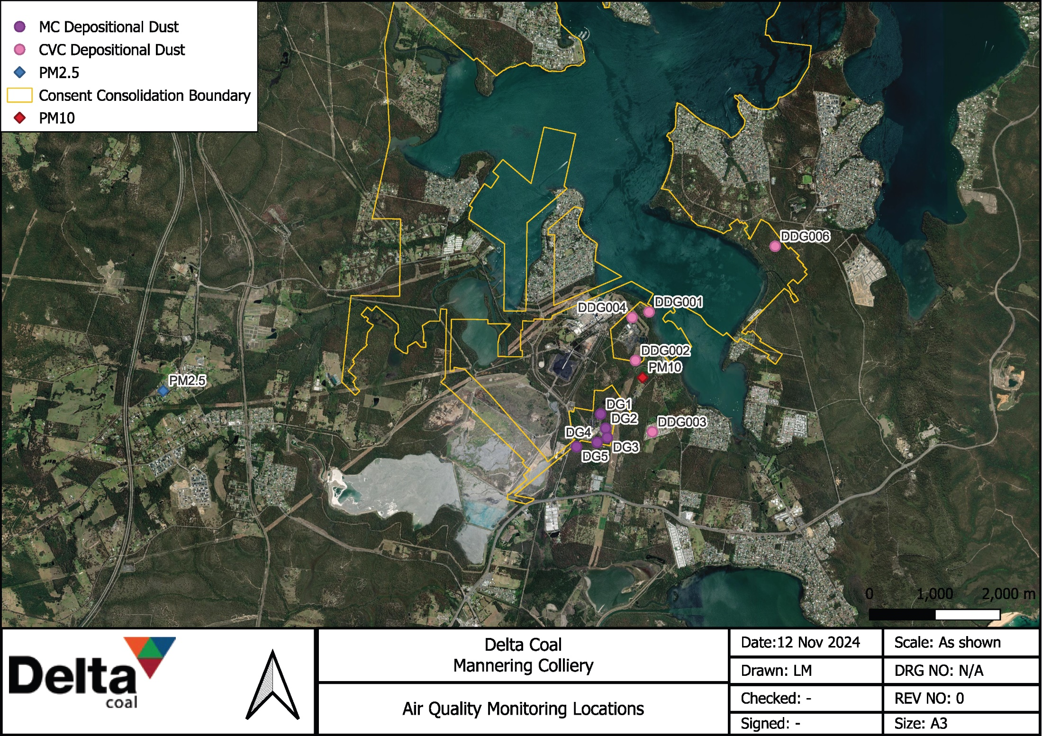

Slide 21
ENVIRONMENTAL PERFORMANCE
CVC Depositional Dust Monitoring

Slide 22
ENVIRONMENTAL PERFORMANCE
MC Depositional Dust Monitoring

Slide 23
ENVIRONMENTAL PERFORMANCE
PM₁₀ Monitoring

Slide 24
ENVIRONMENTAL PERFORMANCE
PM_{2.5} Monitoring

Slide 25
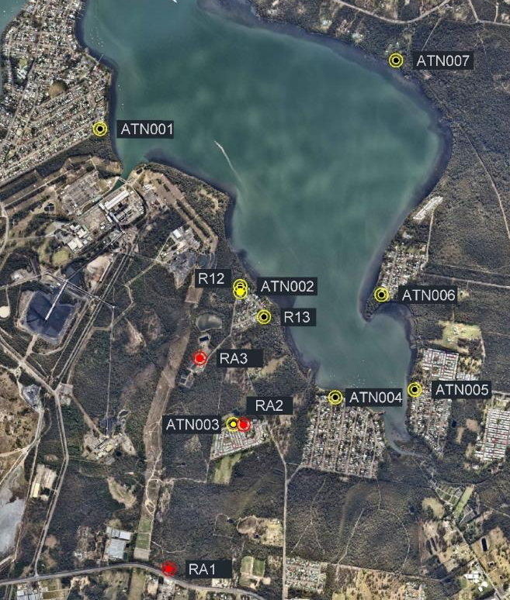
ENVIRONMENTAL PERFORMANCE
R22
Noise Monitoring Locations
Red = MC Monitoring Location
Yellow = CVC Monitoring Location

Slide 26
ENVIRONMENTAL PERFORMANCE
Noise Monitoring – CVC
Monitoring Point | Site Contributions, dB |  | Noise Limit |  | Compliance Status
 | LA_{EQ} (15 min) | LAMAX | LA_{EQ} (15 min) | LAMAX
Chain Valley Colliery Q4 2025
ATN001 | IA | IA | 38 | 45 | ☑
ATN002 | <25 | 51 | 49 | 54 | ☑
ATN003 | IA | IA | 36 | 45 | ☑
ATN004 | <20 | IA | 35 | 45 | ☑
ATN005 | IA | IA | 35 | 45 | ☑
ATN006 | IA | IA | 37 | 45 | ☑
R22 | 45 (43 + 2 LFN) | 40 | 46 | 46 | ☑
R12 | <25 | 51 | 49 | 53 | ☑
R13 | IA | IA | 43 | 49 | ☑
Q4 2025 noise monitoring was undertaken on 27 November, 1, 2, 3 and 5 December 2025.
The highest result for each monitoring location during the monitoring period is presented.
LFN = Low Frequency Noise Penalty.

Slide 27
ENVIRONMENTAL PERFORMANCE
Noise Monitoring – MC
Location | Date | Site Contributions, dB |  | Noise Limits, dB |  | Compliance status
 |  | LAEQ | LAMAX | LAEQ | LAMAX
November 2025
RA1 | 12/11/2025 | <20 | <20 | 36 | 46 | ☑
RA2 |  | <24 | IA | 40 | 45 | ☑
RA3 |  | <28 | IA | 39 | 49 | ☑
December 2025
RA1 | 2/12/2025 | IA | IA | 36 | 46 | ☑
RA2 |  | <25 | <25 | 40 | 45 | ☑
RA3 |  | <20 | IA | 39 | 49 | ☑
January 2026
RA1 | 8/01/2026 | IA | IA | 36 | 46 | ☑
RA2 |  | IA | IA | 40 | 45 | ☑
RA3 |  | IA | IA | 39 | 49 | ☑
No Exceedances for MC noise monitoring between November 2025 and January 2026.
Highest result recorded during monitoring for a location is presented. Monitoring conducted during Evening (6-10pm) and Night period (10pm onward).
IA = Inaudible.

Slide 28
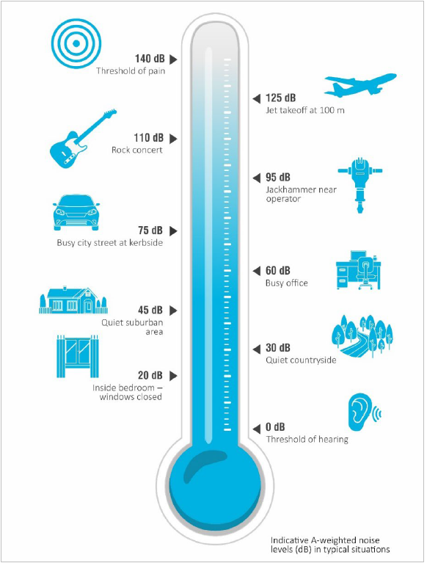
ENVIRONMENTAL PERFORMANCE
Noise Monitoring Noise Comparison

Slide 29
COMMUNITY COMPLAINTS
Community Complaints between 1 November 2026 and 31 January 2026:
Chain Valley Colliery - Nil community complaints received in period.
Mannering Colliery - Nil community complaints received in period.
General Enquiries between 1 November 2026 and 31 January 2026 :
One enquiry from a resident at Summerland Point. Discussion related to potential mining induced movement near a waterfront property. Confirmed there are no current or approved mining activities in that area and that subsidence data indicate all movement are within the range of natural ground movement.

Slide 30
GENERAL BUSINESS
Questions?

